Slide 1
Product Analytics (Final Project Presentation)
Presented by
Sai Krupa Reddy Surarapu
HV18252

Slide 2
Problem Statement
Identify Predictors Affecting Sales: Analyze the dataset to identify the key factors or predictors that significantly affect sales in your online sporting goods store. This could include variables such as customer demographics, browsing behavior, previous purchase history, banner effectiveness, or any other relevant factors. By understanding these predictors, you can optimize your marketing strategies and focus on the most impactful factors to drive sales.
Build a Binary Classification Model: Develop a binary classification model that predicts whether a customer/buyer is likely to make a purchase or not. This model can help you target your marketing efforts more effectively by identifying potential buyers and tailoring promotional campaigns based on their characteristics and behavior. Consider using machine learning algorithms such as logistic regression, decision trees, or random forests to build an accurate and reliable model.
Segment Customers: Utilize clustering techniques to segment your customers based on their behavior and characteristics. By identifying distinct customer segments, you can personalize your marketing strategies, offers, and recommendations to better meet their specific needs and preferences. This approach allows for targeted messaging and can help maximize customer engagement and conversion rates.

Slide 3
Business goal
Perform data analysis.
Identify predictors affecting sales.
Offer a binary classification model for customers / buyers.
Segment customers.

Slide 4
Dataset
Attribute Name | Description
Order_id | Unique Purchase Number (NA For Banner Clicks And Impressions)
User_id | Unique Identifier Of The Client
Page_id | Unique Page Number For Event Bundle (NA For Purchases)
Product | Banner / Purchase Product
Site_version | Version Of The Site (Mobile Or Desktop)
Time | Time Of The Action
Title | Type Of Event (Show, Click Or Purchase)
Target | Target Class

Slide 5
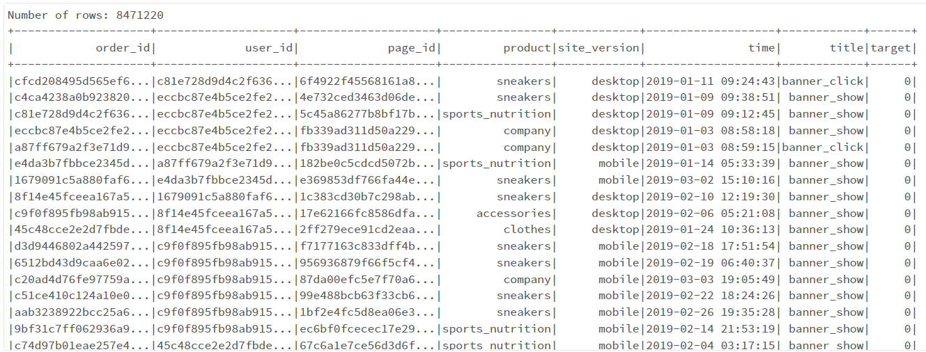
Sample Dataset

Slide 6
Dataset
Attribute Name | Description
Order_id | Unique Purchase Number (NA For Banner Clicks And Impressions)
User_id | Unique Identifier Of The Client
Page_id | Unique Page Number For Event Bundle (NA For Purchases)
Product | Banner / Purchase Product
Site_version | Version Of The Site (Mobile Or Desktop)
Time(Morning,DayLight,Evening, Hour,Day,Weekday,Month) | Time Of The Action
Title(Banner_Show, Banner_click, Order | Type Of Event (Show, Click Or Purchase)
Target | Target Class

Slide 7
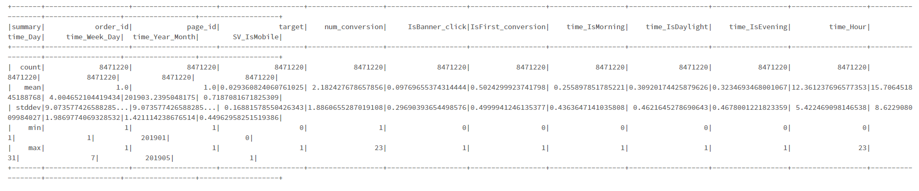
Sample Dataset

Slide 8
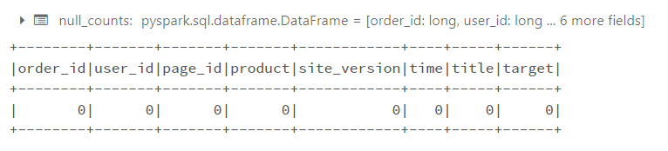
Data Cleaning & Pre-Processing
Null values were checked in the dataset and none were found.
Duplicate values were also checked for and none were detected.

Slide 9
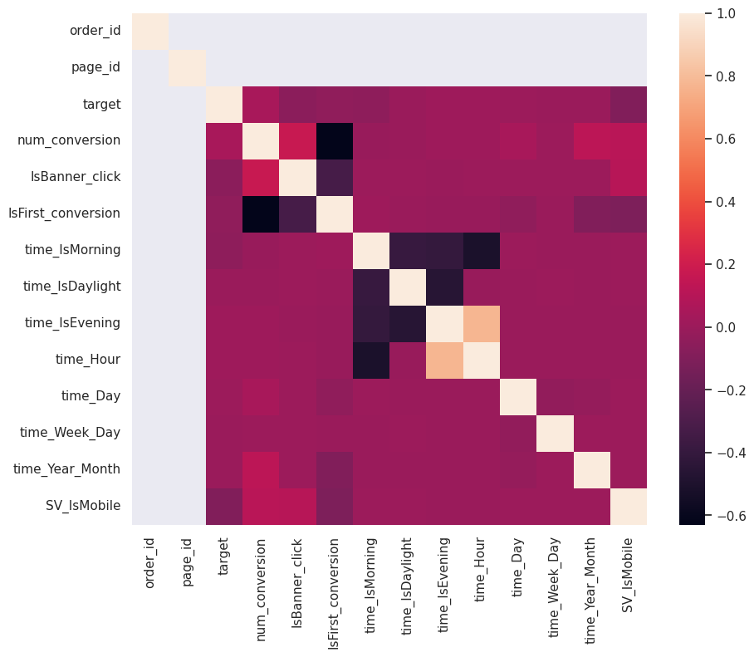
Attribution Correlation

Slide 10
Model Results
Decision Tree
Random Forest

Slide 11
Model Results
Logistic Regression

Slide 12
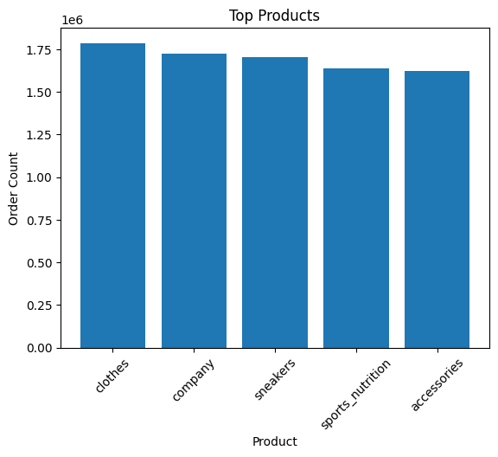
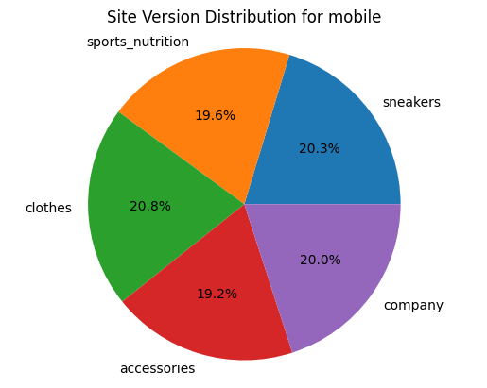
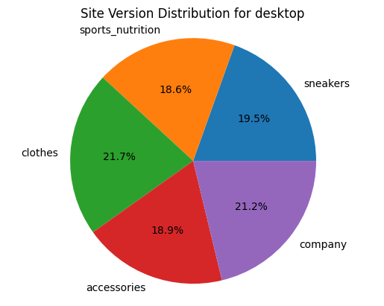
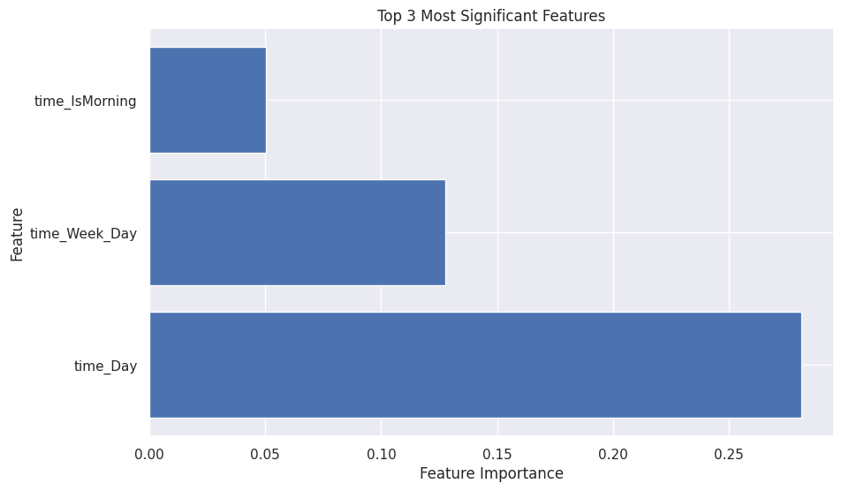
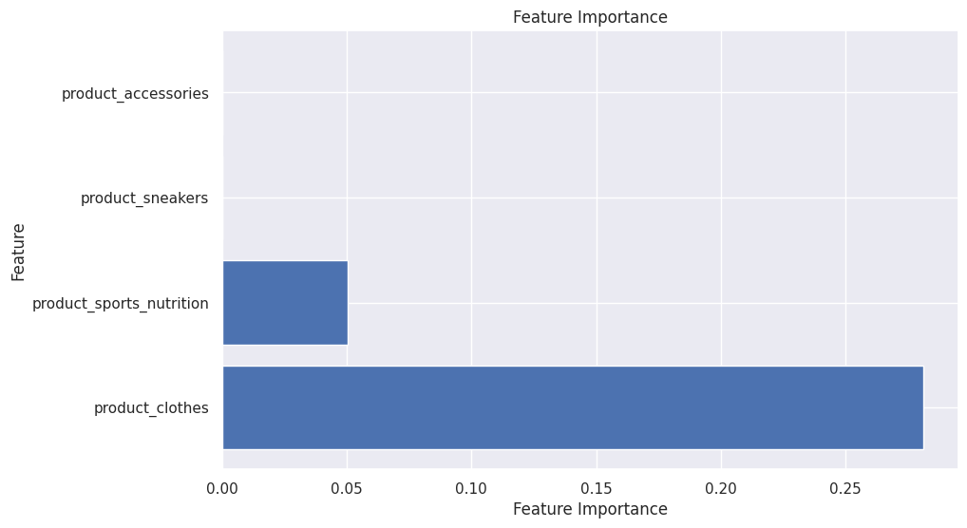
Data Visualizations

Slide 13
Findings
Cluster 2 - customer share 27.38%. The share of “buying” customers is 0.69. Customers buying product_clothes and most often clicking on the banner.
Cluster 1 - customer share 27.38 %. The proportion of "buying" customers is 0.578. The most conversions. The largest share of desktop users.
Cluster 0 - customer share 44.41%. The share of "buying" customers is 0.315. Customers in the categories product_accessories, product_company, product_sports_nutrition. Least click and order products. The target audience. The largest share of "mobile" users. Perhaps the banner is not very attractive in the mobile version.

Slide 14
Benefits
Product_clothes - Product_clothes Is Most Actively Sold, The Largest Number Of Banner Impressions.
Product_sneakers - 2nd Product In Terms Of Popularity And Sales.
Product_accessories And Product_sports_nutrition Need To Research Sales Figures, Add Features.
Time_day - Buy More At The End Of The Month.
Time_hour - Buy More At Night.
Time_year_month - Shopping Activity Increases In The Months With Fewer Weekends And Holidays.
Isbanner_click - People Who Have Ever Clicked On A Banner (Without An Order) Are More Likely To Make A Purchase.
Time_ismorning - In The Morning, Shopping Activity Is Low.

Slide 15
Thank You

